Slide 1

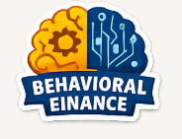
A Behavioral Finance Framework for Mindful Digital Spending
Beyond the Tap: Understanding Digital Spending Behavior and Promoting Mindful Financial Decision-Making
Capstone Project Report
Mudrika Mishra
PGDM (Online)
Jaipuria Institute of Management
Batch: 2024-2026
Notes:
Good morning everyone. My capstone project is based on behavioral finance and digital spending behavior. In this project, I studied how digital payment convenience has changed spending habits and financial awareness among users. The project also proposes a behavioral finance framework called AspiraFi, which focuses on encouraging mindful spending behavior without reducing convenience. India’s rapid UPI growth made this topic very relevant and practical to study.

Slide 2

Business Background
Rapid Growth of Digital Payments
India has witnessed massive growth in UPI-based transactions through platforms like Google Pay, PhonePe, and Paytm.
Digital payments have made financial transactions faster, easier, and more accessible.
Changing consumer spending behavior
Convenience and one-click transactions have increased the frequency of digital spending.
Small daily expenses often go unnoticed, reducing awareness of total spending.
Why this issue matters
Increasing impulsive spending behavior affects financial discipline and saving habits.
Fintech platforms currently prioritize convenience more than mindful financial behavior.
Understanding behavioral patterns is important for creating financially aware digital ecosystems.
Notes:
India has experienced rapid growth in digital payments through platforms such as Google Pay, PhonePe, and Paytm. Payments have become faster, easier, and more accessible for daily transactions. Today, even very small expenses like coffee, food delivery, or subscriptions happen digitally within seconds. However, this convenience has also reduced spending awareness for many users. Sometimes people spend frequently without realizing how much small expenses accumulate over time. This topic became important to study because convenience is increasing, but financial awareness is not always increasing at the same pace.

Slide 3

Problem Statement
The Core Problem
Digital payment systems have reduced the psychological awareness associated with spending money.
Instant and frictionless transactions often encourage impulsive and emotionally driven purchases.
Current Behavioral Concerns
Reduced “pain of paying” in digital transactions.
Increasing habit of unplanned micro-spending.
Limited financial awareness despite high digital payment usage.
Existing Gap in Fintech Platforms
Most digital payment applications focus on transaction speed and convenience.
Limited features exist for mindful spending, spending awareness, or behavioral financial guidance.
Notes:
The main problem identified in this project is reduced psychological awareness during digital spending. Digital transactions are completed instantly, so users often do not feel the same spending awareness compared to cash payments. Many people realize they overspent only at the end of the month, not during the spending process itself. Convenience and frictionless payments may encourage impulsive and emotionally influenced purchases. Current fintech platforms mainly focus on transaction speed and ease of use, but there are limited features supporting mindful financial behavior and spending awareness.

Slide 4

Current Digital Spending Framework
STEP 1
User opens digital payment app
STEP 2
Instant payment completed within seconds
STEP 3
Minimal psychological awareness
STEP 4
Repeated small transaction accumulate over time
STEP 5
Impulsive spending and reduced financial discipline.
Notes:
This slide explains how digital spending currently happens in most payment systems. First, the user opens a digital payment application and completes the transaction instantly within seconds. Because the process is so fast and frictionless, spending often feels almost invisible psychologically. Repeated small transactions then accumulate over time and may reduce financial discipline. For example, people may feel that small daily expenses are not significant individually, but collectively they become larger monthly expenses. Current systems mainly prioritize convenience and speed rather than spending awareness.

Slide 5

Analytical Framework Used
Behavioral Finance Concepts
Pain of paying theory
Impulsive spending behavior
Consumer spending psychology
Financial awareness
Analytical Methods used
Survey-based Analysis
Correlation Analysis
Regression Analysis
Data Visualization
Purpose of framework
To understand Digital Spending Behavior
To Analyze Financial Awareness Patterns
To identify Impulsive Spending Trends
To support the AspiraFi Framework
Notes:
This project is based on concepts from behavioral finance and consumer spending psychology. One important concept used in this project is the pain of paying theory, which explains that people tend to spend more easily when the psychological discomfort of payment is reduced. Digital payments reduce this discomfort because transactions happen quickly and feel less tangible compared to cash. The project also studies impulsive spending behavior and financial awareness patterns. Survey analysis, correlation analysis, and regression analysis were used to understand the relationship between digital payment usage and spending behavior. This framework helps connect psychology with financial decision-making.

Slide 6

Data and Inputs
Primary Data Source
Online survey conducted using Google Forms
Responses collected from digitally active individuals.
Secondary data sources
Research papers
Journals and articles
Behavioral finance studies and digital payment reports
Key variables studied
Digital payment usage
Spending frequency
Financial awareness
Impulsive spending behavior
Emotional spending triggers
Limitations
Limited sample size
time constraints
Responses based on personal behavior and opinions
Notes:
The project uses both primary and secondary sources of data. Primary data was collected through a Google Forms survey focusing on digitally active individuals and their spending behavior. Secondary data included research papers, journals, behavioral finance studies, and digital payment reports. The major variables studied were digital payment usage, spending frequency, financial awareness, impulsive spending behavior, and emotional spending triggers. One interesting observation during the survey was that many people remembered transactions but were not fully aware of their total spending patterns. The project also had limitations such as limited sample size and time constraints.

Slide 7


Analysis output
Key findings from Survey & Analysis
Frequent digital payment users showed higher impulsive spending behavior.
Small online transactions often go unnoticed by users.
Emotional factors influence spending decisions during online purchases.
Many users track payments but not overall spending patterns.
Convenience of UPI reduces the psychological “pain of paying”.
Strategic Insights
Digital convenience increases transaction frequency.
Financial awareness does not always increase with digital literacy.
Users need behavioral support tools within payment platforms.
Notes:
This slide presents the major findings from the survey and behavioral analysis. The analysis showed that frequent digital payment users displayed higher impulsive spending tendencies. Many respondents mentioned that small online transactions often go unnoticed during daily spending. Emotional factors such as stress, excitement, boredom, and discounts also influence spending decisions. Another important observation was that people usually track transactions but not their overall spending habits. This suggests that transaction awareness and financial awareness are not always the same thing. Convenience increased digital payment usage, but not necessarily financial discipline.

Slide 8
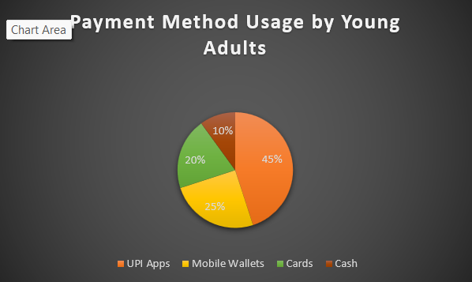
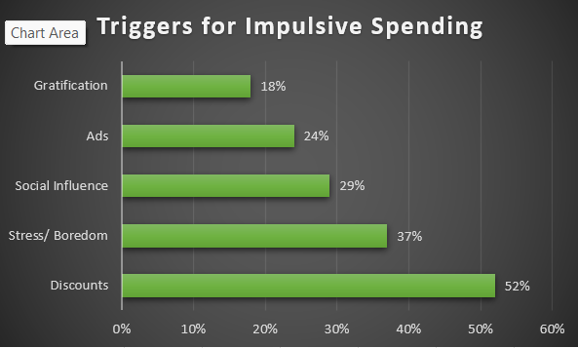

Slide 9

Diagnosis & Problem Identification
What is Wrong in the Current Approach
Digital payment platforms focus mainly on transaction, convenience and speed.
Limited features exist for spending awareness and mindful financial behavior.
Root Causes Identified
Reduced psychological awareness during digital transactions.
Instant gratification and emotional spending
Frequent unnoticed micro-spending
Lack of behavioral finance guidance.
Business Impact of Existing Gaps
Increasing impulsive spending behavior
Reduced financial discipline among users
Lower awareness of long-term financial goals
Financial stress and unhealthy spending habits.

Slide 10


AspiraFi: Proposed Behavioral Finance Framework
Core Features of AspiraFi
Spending awareness score
Goal-based spending Nudges
Emotional spending alerts
Cash-like spending visualization
Mindful spending dashboard
Structural Improvements
Integrates behavioral finance into digital payment systems
Encourages conscious and goal-oriented spending behavior
Creates stronger financial awareness among users.
What Changes Specifically
Users become more aware of spending habits
Payment platforms support mindful financial decisions
Financial discipline improves without reducing convenience.

Slide 11


Implementation plan
Phase 1 – Research & Integration
Identify user behavioral patterns
Integrate AspiraFi features within digital payment platforms
Phase 2 – Pilot Testing
Launch limited testing among selected users
Collect user feedback and behavioral insights
Phase 3 - Behavioral Optimization
Improve nudges, alerts, and awareness features
Customize user experience based on spending patterns
Phase 4 – Full Scale Deployment
Implement framework across digital payment ecosystem
Continuously monitor user engagement and financial behavior
Key stakeholders
Fintech companies
Product design teams
Behavioral finance analysts
Digital payment users.

Slide 12

Financial Impact
Expected Revenue Impact
Increased user engagement within digital payment platforms
Improved customer retention through personalized financial support.
Expected Cost Savings
Reduced financial stress-related user dissatisfaction
Better spending awareness may reduce unnecessary transaction dependency
Expected Margin & Business Benefits
Stronger customer trust and platform loyalty
Enhanced long-term user relationship and engagement.
Estimated Investment Required
Behavioral analytics integration
User interface redesign
Development of awareness and tracking features
Data monitoring and feedback systems

Slide 13

Risk & Governance Controls
Key risks
User privacy and data security concerns
Excessive notification or alert fatigue
Resistance to behavioral spending interventions
Overdependence on automated financial guidance
Mitigation Strategies
Transparent data usage policies
Customizable spending alerts and reminders
User- controlled notification settings
Ethical use of behavioral analytics.
Monitoring Mechanism
Regular tracking of user engagement
Feedback-based feature improvement
Monitoring spending awareness trends
Periodic review of behavioral impact

Slide 14

Performance KPIs
KPI | Current Situation | Expected Target
Spending Awareness Level | Low | Improved Awareness
Impulsive Spending Frequency | High | Reduced Spending
Financial Goal Tracking | Limited | Increased Goal Tracking
User Engagement with Financial Tools | Moderate | Higher Engagement
Mindful Spending Behavior | Inconsistent | More Consistent Behavior
Notes:
This slide presents the Key Performance Indicators that will be used to evaluate the effectiveness of AspiraFi. The KPIs compare the current situation with the expected target after implementation. The first KPI is Spending Awareness Level, where the objective is to increase users’ understanding of their spending habits. The second KPI is Impulsive Spending Frequency, where the aim is to reduce unnecessary and unplanned purchases through behavioral insights and awareness prompts. The third KPI is Financial Goal Tracking, which focuses on encouraging users to actively monitor and achieve their financial objectives. The fourth KPI measures User Engagement with Financial Tools, ensuring that users regularly interact with budgeting and awareness features. Finally, Mindful Spending Behavior evaluates whether users are making more conscious and informed financial decisions. Together, these KPIs help measure the success of AspiraFi in promoting responsible digital spending and improving financial well-being.

Slide 15

Strategic Impact
Competitive Advantage for Fintech Platforms
Differentiates payment platforms through behavioral finance integration
Long-Term Value Creation
Encourages healthier financial habits among users
Builds stronger customer trust and long-term engagement
Supports sustainable digital financial behavior
Organization Capability Enhancement
Strengthens behavioral analytics capabilities
Improves understanding of consumer spending psychology
Encourages innovation in financial technology services.
Notes:
This slide highlights the strategic impact of AspiraFi on both users and organizations. The first impact is creating a competitive advantage for fintech companies by differentiating them from competitors through behavioral finance and spending awareness features. The second impact is long-term value creation, where increased trust, customer loyalty, and responsible financial behavior contribute to sustainable growth. The third impact is organizational capability enhancement. By understanding customer spending patterns and behavioral insights, organizations can improve decision-making, product development, and customer engagement strategies. Overall, AspiraFi delivers value beyond individual users by strengthening business performance and supporting long-term organizational success.

Slide 16

Executive Summary & Recommendation
Key Findings
Digital payment convenience influences impulsive spending behavior
Reduced “ pain of paying” lowers spending awareness among users.
Existing fintech platforms provide limited behavioral financial support
Proposed Recommendation
Integrate the AspiraFi behavioral finance framework into digital payment platforms
Use awareness tools, spending nudges, and behavioral insights to encourage mindful spending
Expected Outcomes
Improved financial awareness
Reduced impulsive spending behavior
Stronger customer engagement and trust
More responsible digital financial habits
Final Conclusion
Digital convenience should be supported by financial awareness
Future fintech systems should focus not only on speed, but also on mindful financial behavior.
Notes:
This slide summarizes the key findings, recommendations, and overall conclusion of the study. The research found that digital payment systems have significantly improved convenience but may also reduce spending awareness and encourage impulsive spending behavior. The study highlights the importance of behavioral finance in understanding these spending patterns. Based on these findings, the recommendation is to integrate behavioral awareness tools, goal-based nudges, and financial guidance features into digital payment ecosystems. The proposed framework, AspiraFi, aims to bridge the gap between convenience and awareness by helping users better understand their financial behavior. The expected outcome is improved spending awareness, reduced impulsive spending, stronger financial discipline, and enhanced user engagement. In conclusion, the study demonstrates that combining digital convenience with behavioral finance principles can promote more mindful and responsible financial decision-making.

Slide 17


